Slide 1
String Matching
CSE 205 Algorithms

Slide 2
Pattern Matching
Given a text string T[0..n-1] and a pattern P[0..m-1], find all occurrences of the pattern within the text.
Example: T = 000010001010001 and P = 0001, the occurrences are:
  first occurrence starts at T[1]
  second occurrence starts at T[5]
  third occurrence starts at T[11]

Slide 3
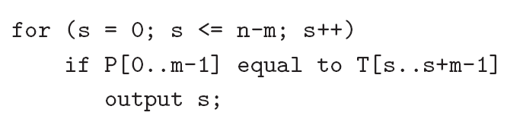
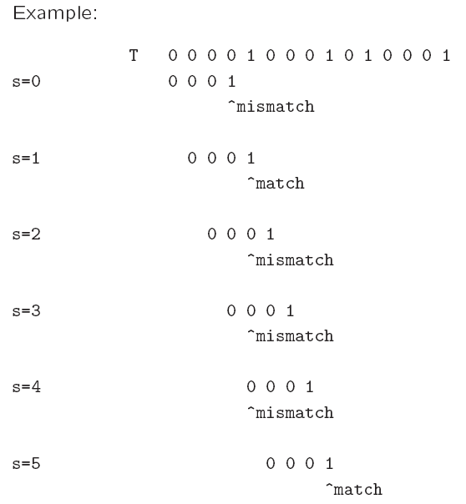
Naïve algorithm
Worst-case running time = O(nm).

Slide 4
Rabin-Karp Algorithm
Key idea:
  think of the pattern P[0..m-1] as a key, transform (hash) it into an equivalent integer p
  Similarly, we transform substrings in the text string T[] into integers
    For s=0,1,…,n-m, transform T[s..s+m-1] to an equivalent integer t_{s}
  The pattern occurs at position s if and only if p=t_{s}
If we compute p and t_{s} quickly, then the pattern matching problem is reduced to comparing p with n-m+1 integers

Slide 5
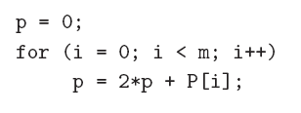
Rabin-Karp Algorithm …
How to compute p?
  p = 2^{m-1} P[0] + 2^{m-2} P[1] + … + 2 P[m-2] + P[m-1]
Using horner’s rule
This takes O(m) time, assuming each arithmetic operation can be done in O(1) time.

Slide 6
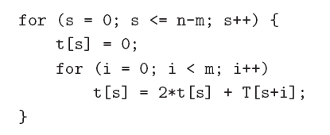
Rabin-Karp Algorithm …
Similarly, to compute the (n-m+1) integers t_{s} from the text string
This takes O((n – m + 1) m) time, assuming that each arithmetic operation can be done in O(1) time.
This is a bit time-consuming.

Slide 7
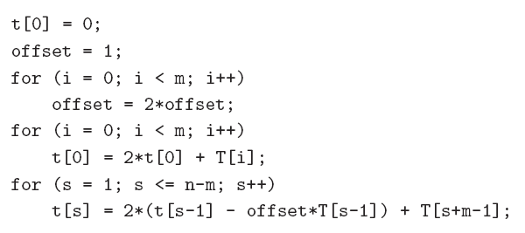
Rabin-Karp Algorithm
A better method to compute the integers is:
This takes O(n+m) time, assuming that each arithmetic operation can be done in O(1) time.

Slide 8
Problem
The problem with the previous strategy is that when m is large, it is unreasonable to assume that each arithmetic operation can be done in O(1) time.
  In fact, given a very long integer, we may not even be able to use the default integer type to represent it.
Therefore, we will use modulo arithmetic. Let q be a prime number so that 2q can be stored in one computer word.
  This makes sure that all computations can be done using single-precision arithmetic.

Slide 9
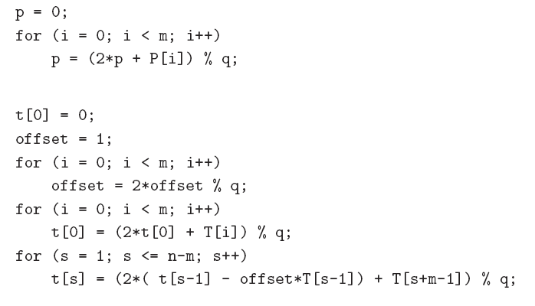

Slide 10
Once we use the modulo arithmetic, when p=t_{s} for some s, we can no longer be sure that P[0 .. M-1] is equal to T[s .. S+ m -1 ]
Therefore, after the equality test p = t_{s}, we should compare P[0..m-1] with T[s..s+m-1] character by character to ensure that we really have a match.
So the worst-case running time becomes O(nm), but it avoids a lot of unnecessary string matchings in practice.

Slide 11
The Knuth-Morris-Pratt Algorithm
Knuth, Morris and Pratt proposed a linear time algorithm for the string matching problem.
A matching time of O(n) is achieved by avoiding comparisons with elements of ‘S’ that have previously been involved in comparison with some element of the pattern ‘p’ to be matched. i.e., backtracking on the string ‘S’ never occurs

Slide 12
Components of KMP algorithm
The prefix function, Π
The prefix function,Π for a pattern encapsulates knowledge about how the pattern matches against shifts of itself. This information can be used to avoid useless shifts of the pattern ‘p’. In other words, this enables avoiding backtracking on the string ‘S’.
The KMP Matcher
With string ‘S’, pattern ‘p’ and prefix function ‘Π’ as inputs, finds the occurrence of ‘p’ in ‘S’ and returns the number of shifts of ‘p’ after which occurrence is found.

Slide 13
The prefix function, Π
Following pseudocode computes the prefix fucnction, Π:
Compute-Prefix-Function (p)
1 m ← length[p] //’p’ pattern to be matched
2 Π[1] ← 0
3 k ← 0
for q ← 2 to m
while k > 0 and p[k+1] != p[q]
6 do k ← Π[k]
If p[k+1] = p[q]
then k ← k +1
Π[q] ← k
10 return Π

Slide 14
Example: compute Π for the pattern ‘p’ below:
p
a | b | a | b | a | c | a
Initially: m = length[p] = 7
Π[1] = 0
k = 0
Step 1: q = 2, k=0
Π[2] = 0
Step 2: q = 3, k = 0,
Π[3] = 1
Step 3: q = 4, k = 1
Π[4] = 2
q | 1 | 2 | 3 | 4 | 5 | 6 | 7
p | a | b | a | b | a | c | a
Π | 0 | 0
q | 1 | 2 | 3 | 4 | 5 | 6 | 7
p | a | b | a | b | a | c | a
Π | 0 | 0 | 1
q | 1 | 2 | 3 | 4 | 5 | 6 | 7
p | a | b | a | b | a | c | A
Π | 0 | 0 | 1 | 2

Slide 15
Step 4: q = 5, k =2
Π[5] = 3
Step 5: q = 6, k = 3
Π[6] = 0
Step 6: q = 7, k = 1
Π[7] = 1
After iterating 6 times, the prefix function computation is complete: →
q | 1 | 2 | 3 | 4 | 5 | 6 | 7
p | a | b | a | b | a | c | a
Π | 0 | 0 | 1 | 2 | 3
q | 1 | 2 | 3 | 4 | 5 | 6 | 7
p | a | b | a | b | a | c | a
Π | 0 | 0 | 1 | 2 | 3 | 0
q | 1 | 2 | 3 | 4 | 5 | 6 | 7
p | a | b | a | b | a | c | a
Π | 0 | 0 | 1 | 2 | 3 | 0 | 1
q | 1 | 2 | 3 | 4 | 5 | 6 | 7
p | a | b | A | b | a | c | a
Π | 0 | 0 | 1 | 2 | 3 | 0 | 1

Slide 16
The KMP Matcher
The KMP Matcher, with pattern ‘p’, string ‘S’ and prefix function ‘Π’ as input, finds a match of p in S.
Following pseudo code computes the matching component of KMP algorithm:
KMP-Matcher(S,p)
1 n ← length[S]
2 m ← length[p]
3 Π ← Compute-Prefix-Function(p)
4 q ← 0 //number of characters matched
5 for i ← 1 to n //scan S from left to right
6 while q > 0 and p[q+1] != S[i]
do q ← Π[q] //next character does not match
if p[q+1] = S[i]
then q ← q + 1 //next character matches
if q = m //is all of p matched?
then print “Pattern occurs with shift” i – m
q ← Π[ q] // look for the next match
Note: KMP finds every occurrence of a ‘p’ in ‘S’. That is why KMP does not terminate in step 12, rather it searches remainder of ‘S’ for any more occurrences of ‘p’.

Slide 17
Illustration: given a String ‘S’ and pattern ‘p’ as follows:
S
b | a | c | b | a | b | a | b | a | b | a | c | a | c | a
p
a | b | a | b | a | c | a
Let us execute the KMP algorithm to find whether ‘p’ occurs in ‘S’.
For ‘p’ the prefix function, Π was computed previously and is as follows:
q | 1 | 2 | 3 | 4 | 5 | 6 | 7
p | a | b | A | b | a | c | a
Π | 0 | 0 | 1 | 2 | 3 | 0 | 1

Slide 18
Initially: n = size of S = 15;
m = size of p = 7
Step 1: i = 1, q = 0
comparing p[1] with S[1]
S
b | a | c | b | a | b | a | b | a | b | a | c | a | a | b
p
a | b | a | b | a | c | a
P[1] does not match with S[1]. ‘p’ will be shifted one position to the right.
Step 2: i = 2, q = 0
comparing p[1] with S[2]
S
b | a | c | b | a | b | a | b | a | b | a | c | a | a | b
p
a | b | a | b | a | c | a
P[1] matches S[2]. Since there is a match, p is not shifted.

Slide 19
Step 3: i = 3, q = 1
Comparing p[2] with S[3]
p[2] does not match with S[3]
S
b | a | c | b | a | b | a | b | a | b | a | c | a | a | b
p
a | b | a | b | a | c | a
Backtracking on p, comparing p[1] and S[3]
Step 4: i = 4, q = 0
comparing p[1] with S[4]
p[1] does not match with S[4]
S
b | a | c | b | a | b | a | b | a | b | a | c | a | a | b
p
a | b | a | b | a | c | a
Step 5: i = 5, q = 0
comparing p[1] with S[5]
p[1] matches with S[5]
S
b | a | c | b | a | b | a | b | a | b | a | c | a | a | b
p
a | b | a | b | a | c | a

Slide 20
Step 6: i = 6, q = 1
Comparing p[2] with S[6]
p[2] matches with S[6]
S
b | a | c | b | a | b | a | b | a | b | a | c | a | a | b
p
a | b | a | b | a | c | a
Step 7: i = 7, q = 2
Comparing p[3] with S[7]
p[3] matches with S[7]
S
b | a | c | b | a | b | a | b | a | b | a | c | a | a | b
p
a | b | a | b | a | c | a
Step 8: i = 8, q = 3
Comparing p[4] with S[8]
p[4] matches with S[8]
S
b | a | c | b | a | b | a | b | a | b | a | c | a | a | b
p
a | b | a | b | a | c | a

Slide 21
Step 9: i = 9, q = 4
Comparing p[5] with S[9]
p[5] matches with S[9]
S
b | a | c | b | a | b | a | b | a | b | a | c | a | a | b
p
a | b | a | b | a | c | a
Step 10: i = 10, q = 5
Comparing p[6] with S[10]
p[6] doesn’t match with S[10]
S
b | a | c | b | a | b | a | b | a | b | a | c | a | a | b
p
a | b | a | b | a | c | a
Backtracking on p, comparing p[4] with S[10] because after mismatch q = Π[5] = 3
Step 11: i = 11, q = 4
Comparing p[5] with S[11]
p[5] matches with S[11]
b | a | c | b | a | b | a | b | a | b | a | c | a | a | b
S
p
a | b | a | b | a | c | a

Slide 22
Step 12: i = 12, q = 5
Comparing p[6] with S[12]
p[6] matches with S[12]
S
b | a | c | b | a | b | a | b | a | b | a | c | a | a | b
p
a | b | a | b | a | c | a
Step 13: i = 13, q = 6
Comparing p[7] with S[13]
p[7] matches with S[13]
S
b | a | c | b | a | b | a | b | a | b | a | c | a | a | b
p
a | b | a | b | a | c | a
Pattern ‘p’ has been found to completely occur in string ‘S’. The total number of shifts
that took place for the match to be found are: i – m = 13 – 7 = 6 shifts.

Slide 23
Running - time analysis
KMP Matcher
1 n ← length[S]
2 m ← length[p]
3 Π ← Compute-Prefix-Function(p)
4 q ← 0
5 for i ← 1 to n
6 while q > 0 and p[q+1] != S[i]
q ← Π[q]
if p[q+1] = S[i]
then q ← q + 1
if q = m
then print “Pattern occurs with shift” i – m
q ← Π[ q]
The for loop beginning in step 5 runs ‘n’ times, i.e., as long as the length of the string ‘S’. Since step 1 to step 4 take constant time, the running time is dominated by this for loop. Thus running time of matching function is Θ(n).
Compute-Prefix-Function (Π)
1 m ← length[p] //’p’ pattern to be matched
2 Π[1] ← 0
3 k ← 0
for q ← 2 to m
while k > 0 and p[k+1] != p[q]
6 do k ← Π[k]
If p[k+1] = p[q]
then k ← k +1
Π[q] ← k
return Π
In the above pseudocode for computing the prefix function, the for loop from step 4 to step 10 runs ‘m’ times. Step 1 to step 3 take constant time. Hence the running time of compute prefix function is Θ(m).

